Slide 1
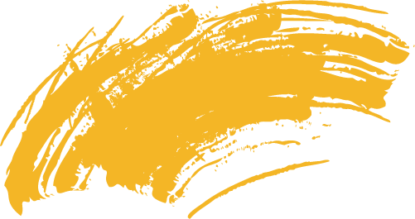
Automating animation with AI
BBCS Group 5: CGA

Slide 2
01
PURPOSE

Slide 3
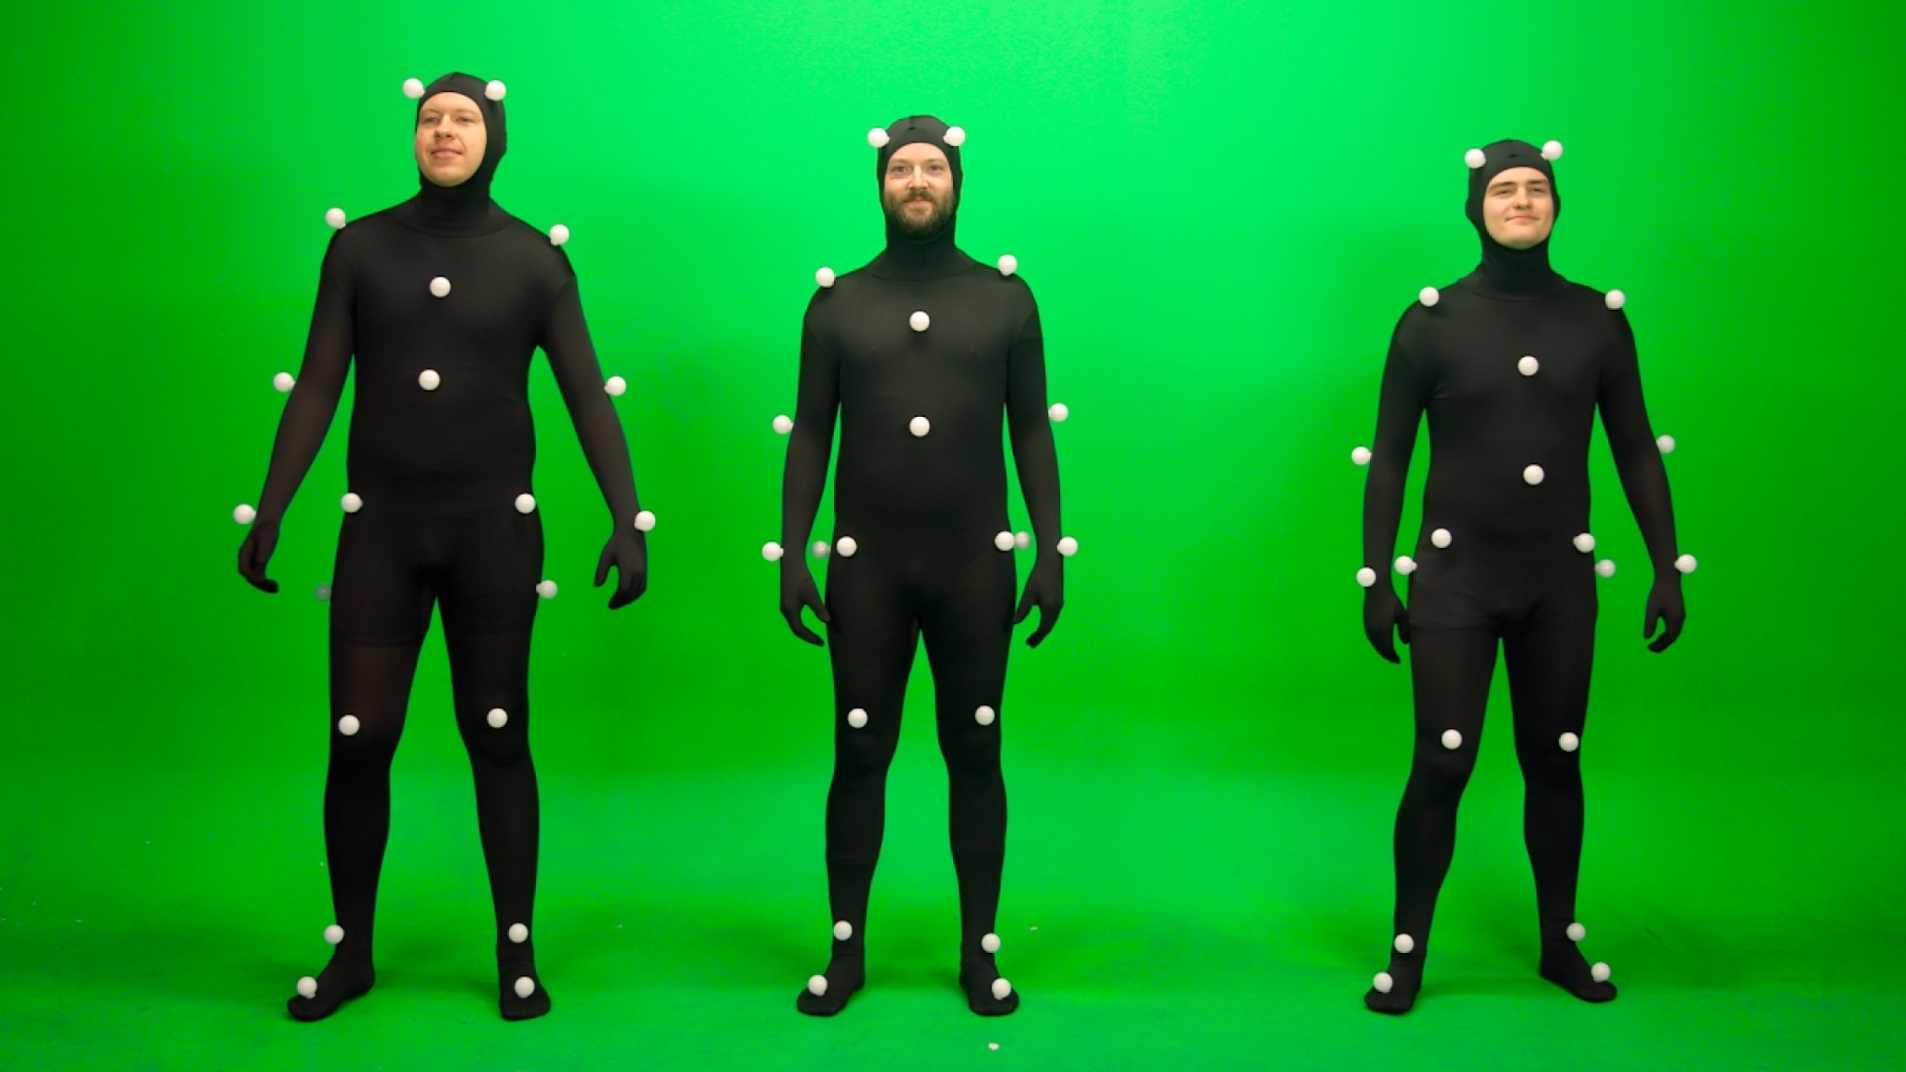
Purpose of prototype
As a group our goal was to make improvements on the art of motion capture to make it more efficient , less time consuming and accessible to more people. Through we hope that people would have a better experience of motion capture, and encourage others to try it to .
This prototype does not require the use of a mocap suit. However it still functions similarly by using a code that pinpoints the motion using the landmarks of your body such as the cheek bones. Hence this makes it more access and usable to a wider community.

Slide 4
02
CONCEPTS

Slide 5
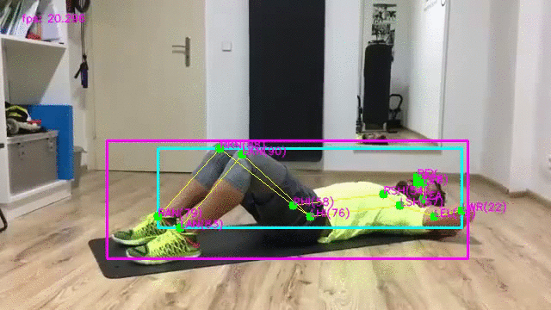
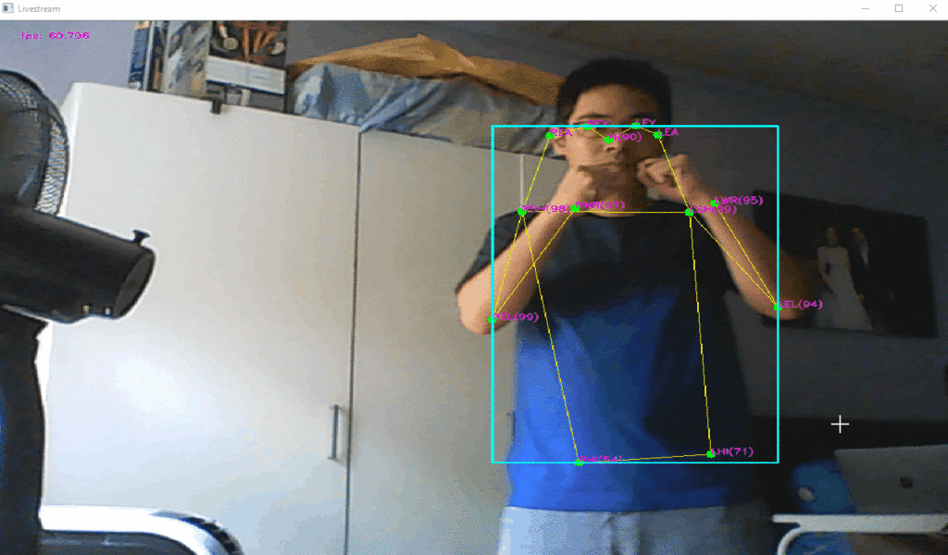
AI BRICKS
Pose Estimation
The detection and localisation of various joint/skeletal points on images.
We can use this concept to estimate the pose of the person, to model the AI character.
Activity Classification
Identification of activities using data driven approaches.
We can have a library of activities of the character so that it will be easier for the AI to generate the different poses.

Slide 6
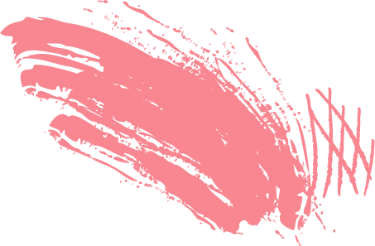

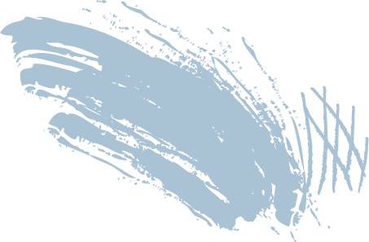


AI Face Body and Hand Pose Detection with Python and Mediapipe
#1. Get Real time
Webcam Feed
# 2. Make Detections
from Feed
Detect Facial Landmarks
Detect Hand Poses
Detect Body Poses
#0. Install and Import Dependencies
# 4. Capturing
Animation Video
# 3. Apply Styling
Full code can be found in
Media Pipe BBCS 2021.ipynb

Slide 7
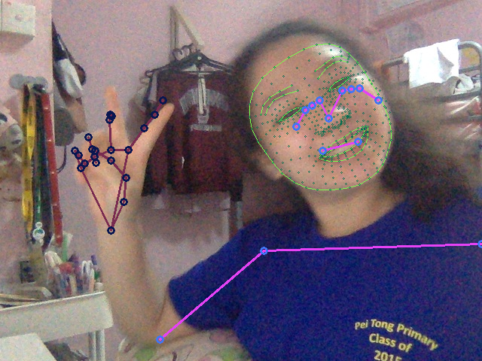
How it works?
MediaPipe Hands and Face Mesh Solutions
What’s this?
A machine Learning pipeline!
Identifying Region of Interest (ROIs)
Face
Hand
Body

Slide 8
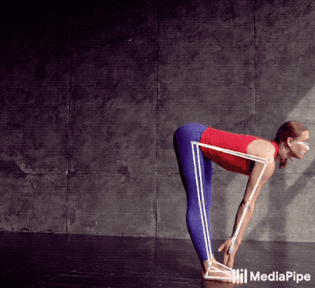
How it works?
Locate the person within the frame
Predicts the pose landmarks
Connects landmarks according to categories (e.g the shoulders in body pose)
It consists of:
Face detection
Face mesh
Hands
Pose
https://google.github.io/mediapipe/solutions/pose

Slide 9
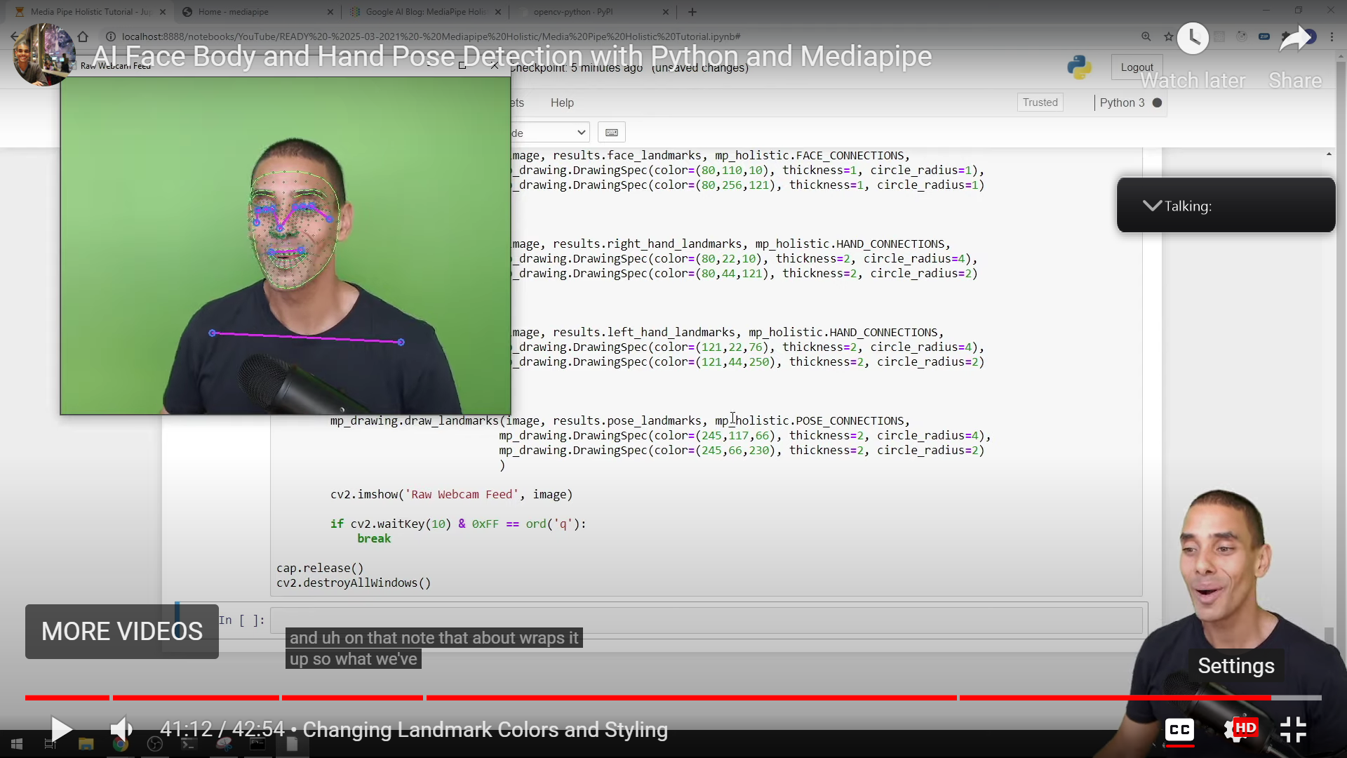
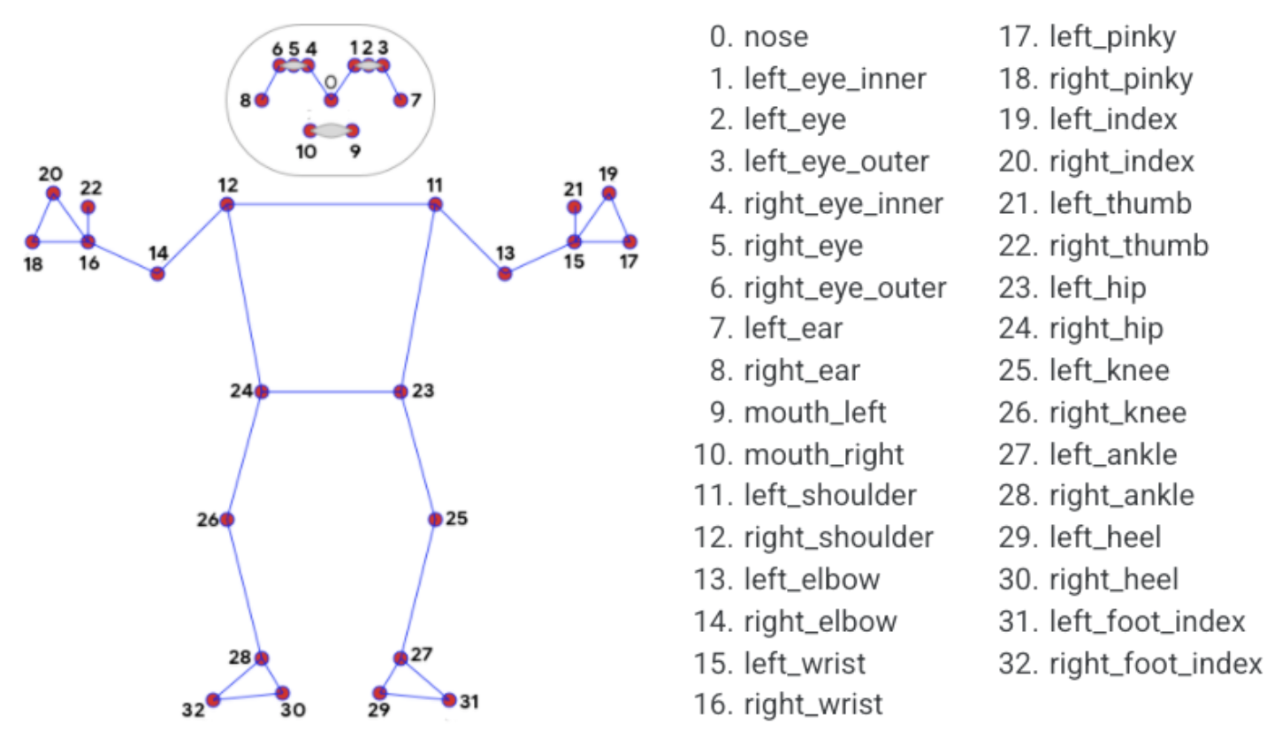
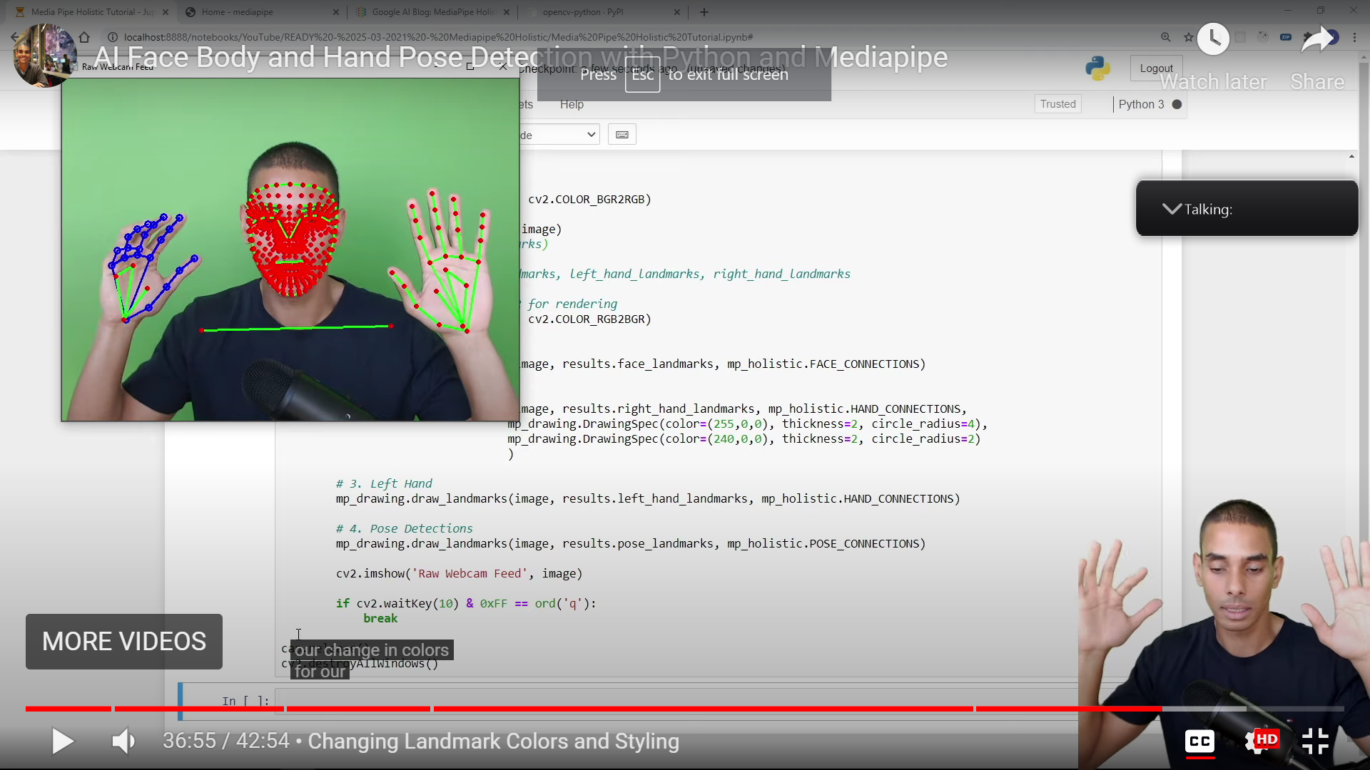
BlazePose 33 keypoint topology

Slide 10
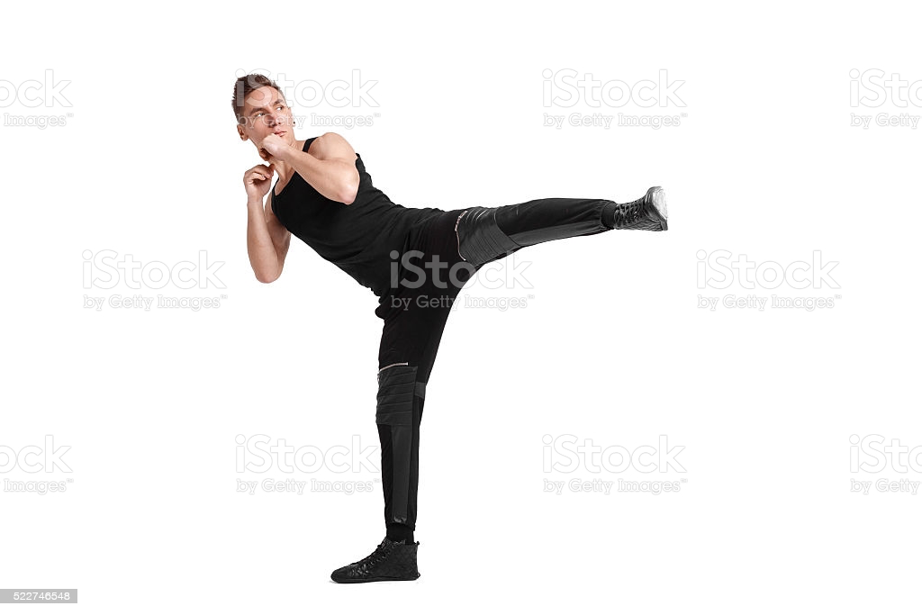
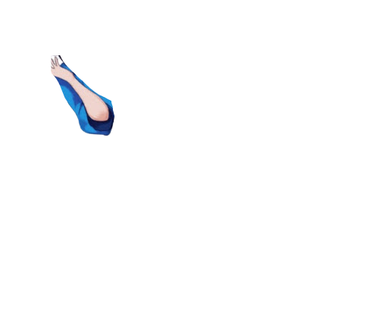
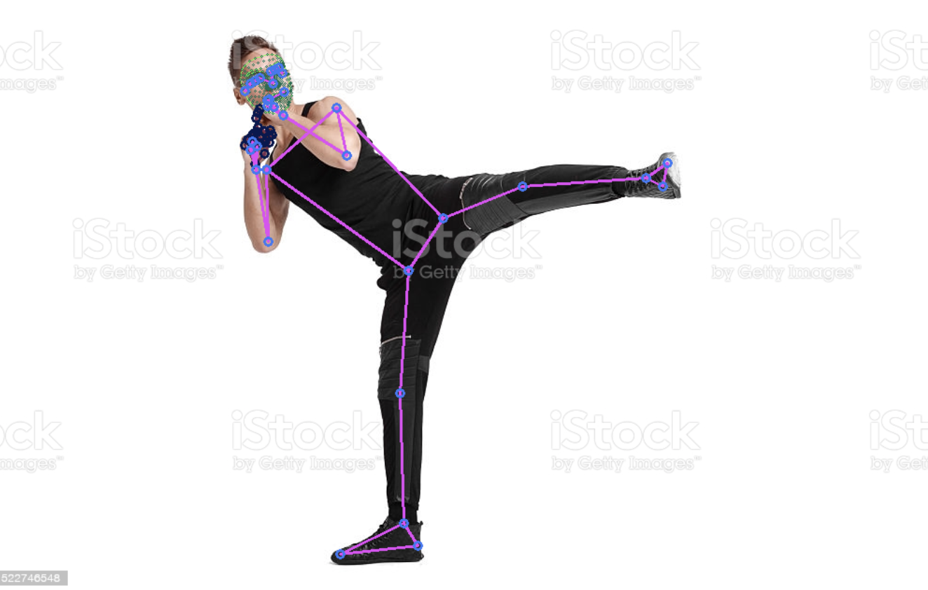
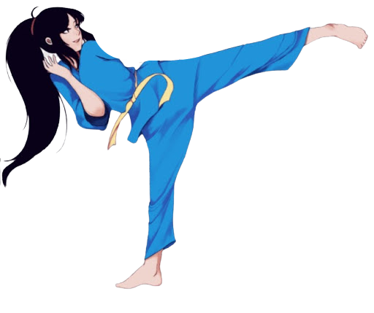
Example
Original movement. 2. Landmarks pinpointed. 3. Character implemented

Slide 11
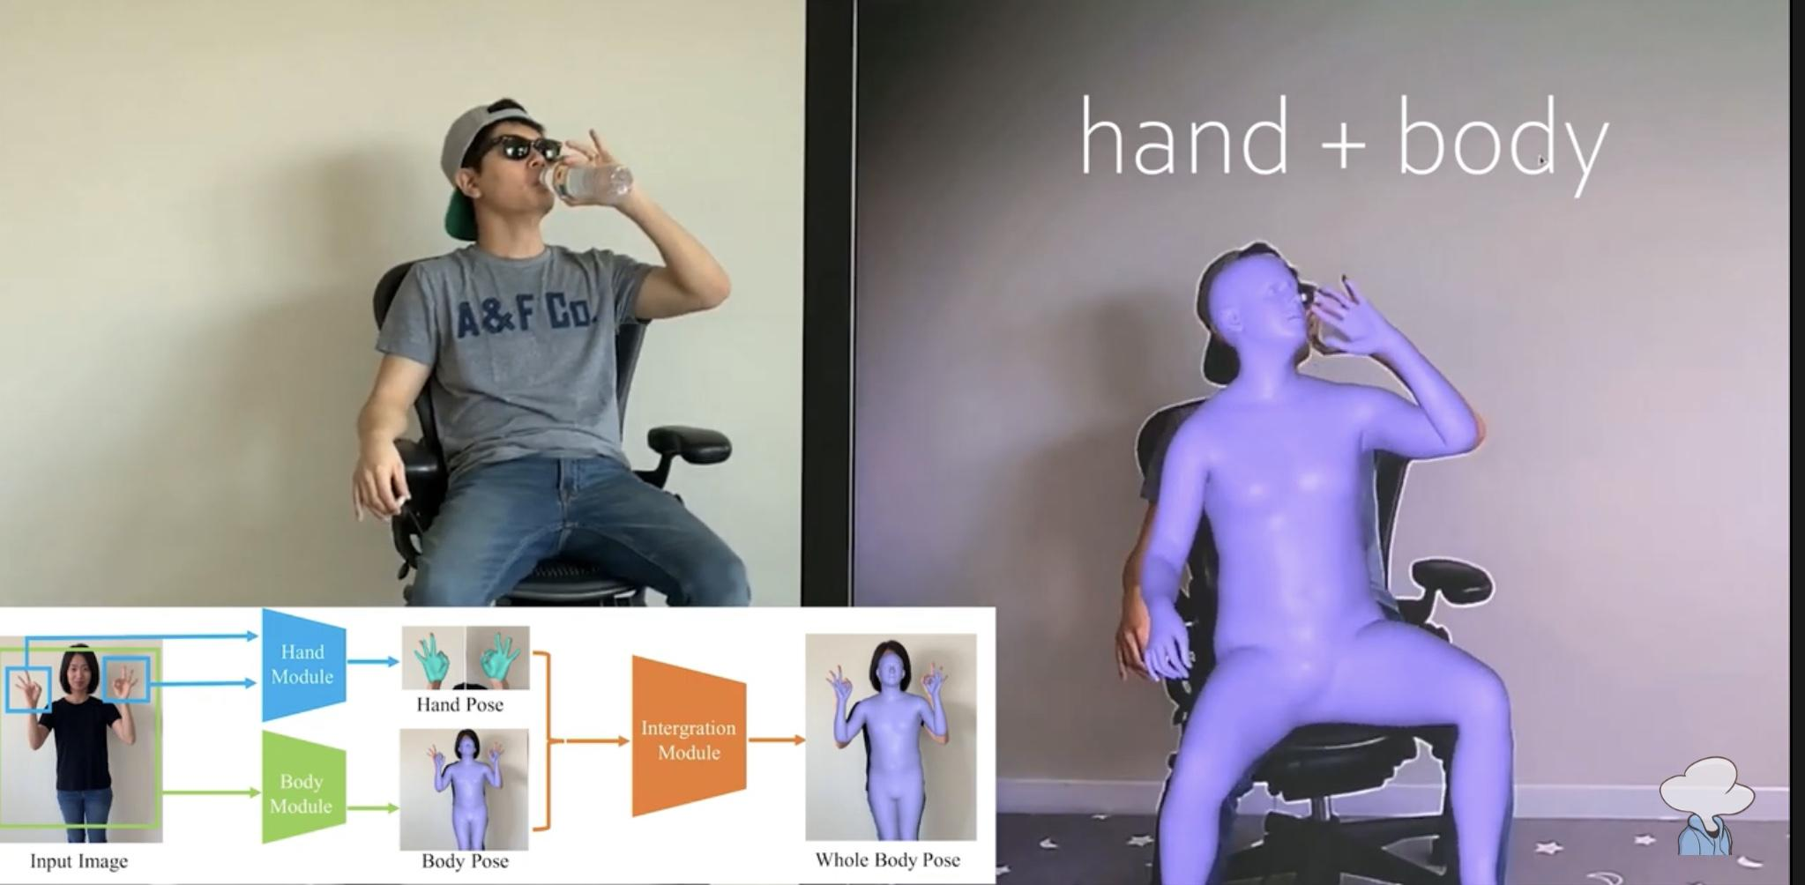
Example

Slide 12
AI Face Body and Hand Pose Detection with Python and Mediapipe
Using Mediapipe Library and a webcam, we can have:
Body pose detection
Facial landmark estimation
Hand pose detection
These detections are given as points which we can then map to our animated figure
We have successfully created the detection systems, but are still working on the application to the animated figures

Slide 13
03
CODES

Slide 14
The code (full version on GitHub)
import mediapipe as mp
import cv2 as cv2
from google.colab.patches import cv2_imshow
# 1. Draw face landmarks
mp_drawing.draw_landmarks(image, results.face_landmarks, mp_holistic.FACE_CONNECTIONS,
mp_drawing.DrawingSpec(color=(80,110,10), thickness=1, circle_radius=1),
mp_drawing.DrawingSpec(color=(80,256,121), thickness=1, circle_radius=1)
)
# 2. Right hand
mp_drawing.draw_landmarks(image, results.right_hand_landmarks, mp_holistic.HAND_CONNECTIONS,
mp_drawing.DrawingSpec(color=(80,22,10), thickness=2, circle_radius=4),
mp_drawing.DrawingSpec(color=(80,44,121), thickness=2, circle_radius=2)
)
# 3. Left Hand
mp_drawing.draw_landmarks(image, results.left_hand_landmarks, mp_holistic.HAND_CONNECTIONS,
mp_drawing.DrawingSpec(color=(121,22,76), thickness=2, circle_radius=4),
mp_drawing.DrawingSpec(color=(121,44,250), thickness=2, circle_radius=2)
)
# 4. Pose Detections
mp_drawing.draw_landmarks(image, results.pose_landmarks, mp_holistic.POSE_CONNECTIONS,
mp_drawing.DrawingSpec(color=(245,117,66), thickness=2, circle_radius=4),
mp_drawing.DrawingSpec(color=(245,66,230), thickness=2, circle_radius=2)
)
cv2_imshow(image)
if cv2.waitKey(10) & 0xFF == ord('q'):
break
cap.release()
cv2.destroyAllWindows()
cap = cv2.VideoCapture(0)
# Initiate holistic model
with mp_holistic.Holistic(min_detection_confidence=0.5, min_tracking_confidence=0.5) as holistic:
#ret, frame = cap.read()
frame = cv2.imread("Unknown.jpg")
# Recolor Feed
image = cv2.cvtColor(frame, cv2.COLOR_BGR2RGB)
# Make Detections
results = holistic.process(image)
# print(results.face_landmarks)
# face_landmarks, pose_landmarks, left_hand_landmarks, right_hand_landmarks
# Recolor image back to BGR for rendering
image = cv2.cvtColor(image, cv2.COLOR_RGB2BGR)

Slide 15
The code (full version on GitHub)
cap = cv2.VideoCapture(0)
# Initiate holistic model
with mp_holistic.Holistic(min_detection_confidence=0.5, min_tracking_confidence=0.5) as holistic:
#ret, frame = cap.read()
frame = cv2.imread("Unknown.jpg")
# Recolor Feed
image = cv2.cvtColor(frame, cv2.COLOR_BGR2RGB)
# Make Detections
results = holistic.process(image)
# print(results.face_landmarks)
# face_landmarks, pose_landmarks, left_hand_landmarks, right_hand_landmarks
# Recolor image back to BGR for rendering
image = cv2.cvtColor(image, cv2.COLOR_RGB2BGR)

